Slide 1





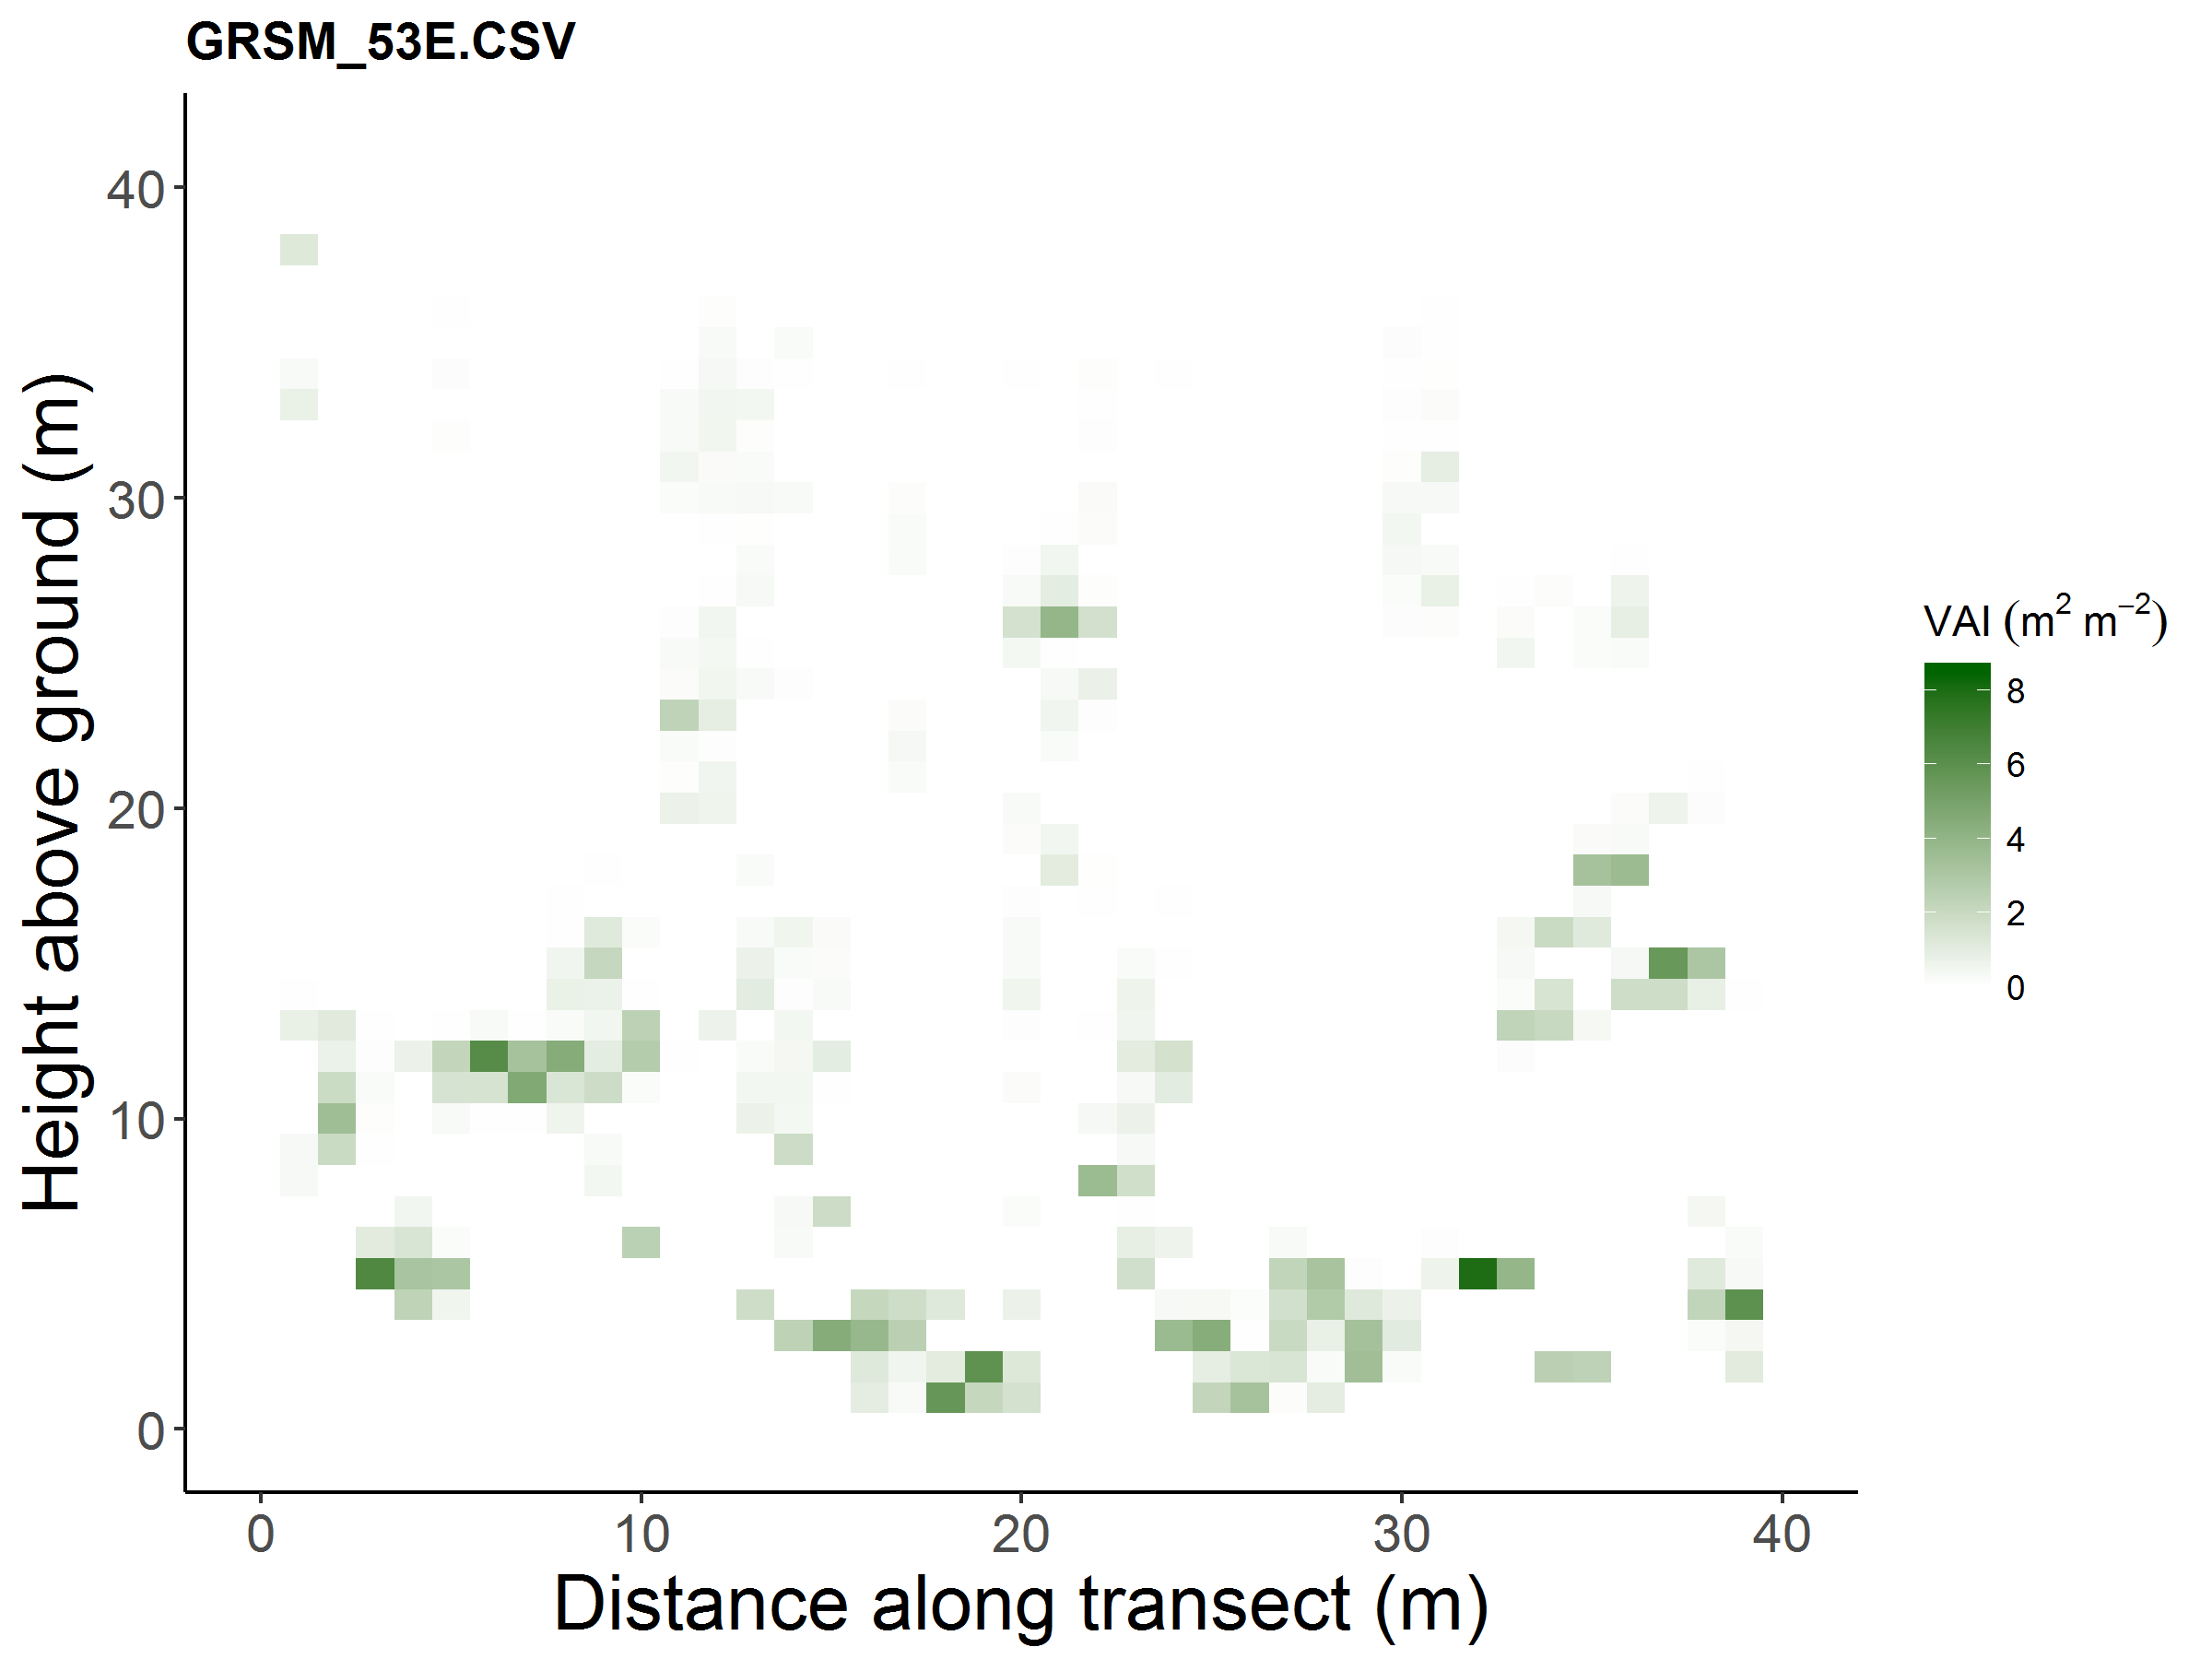
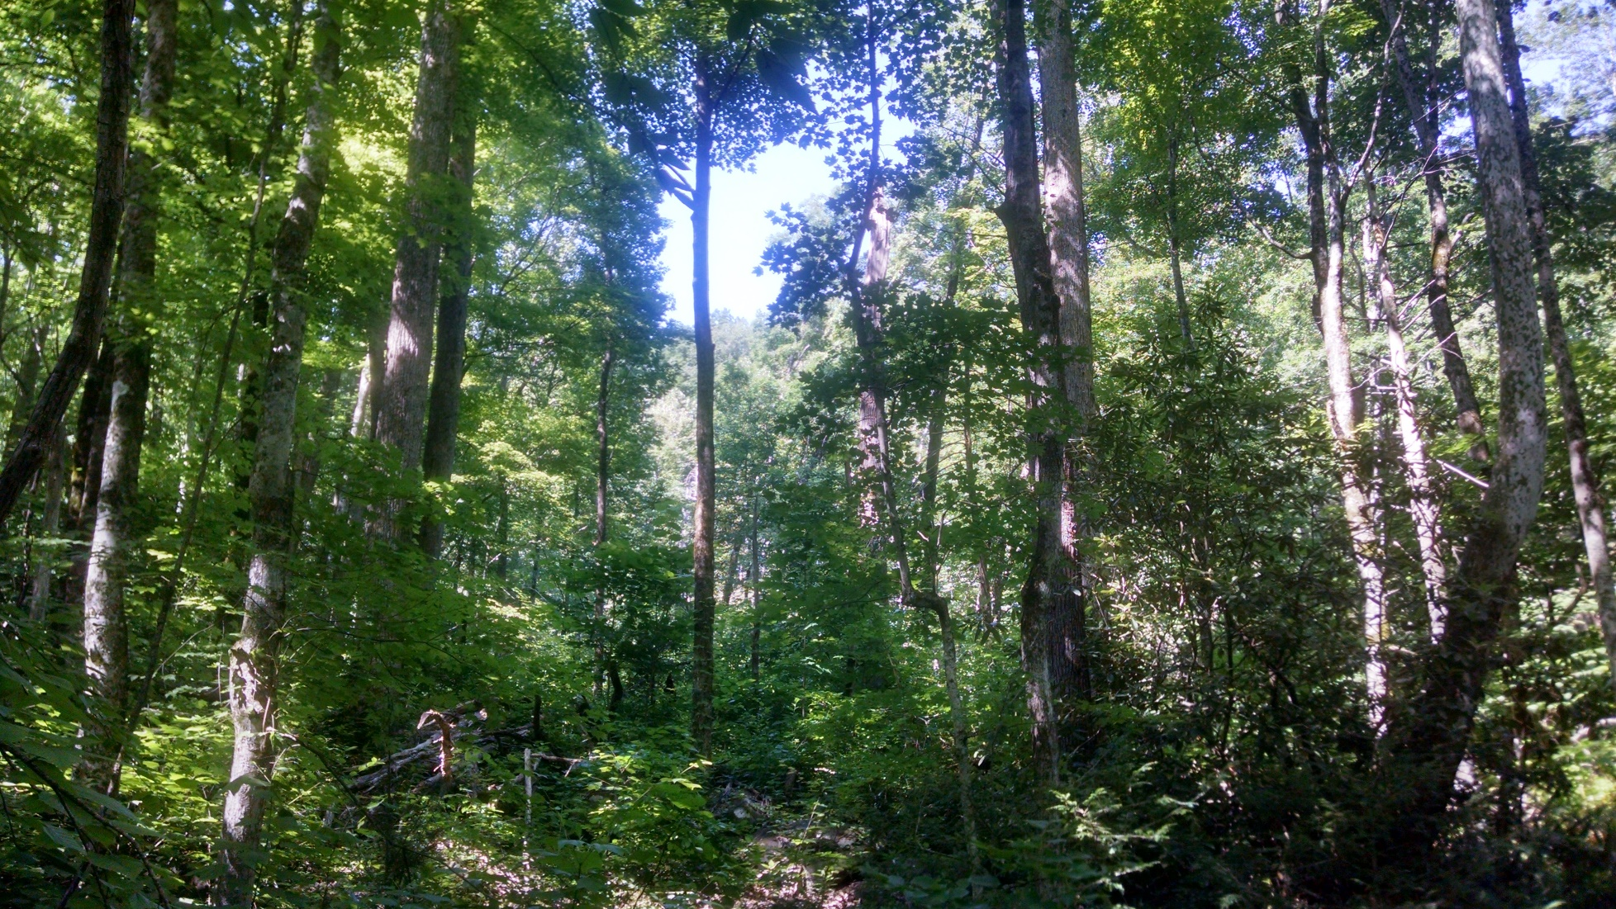
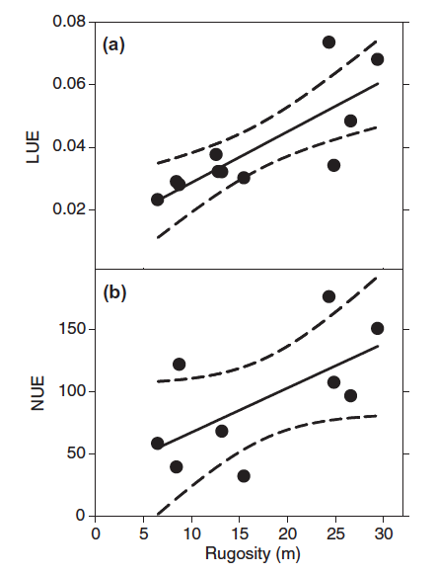
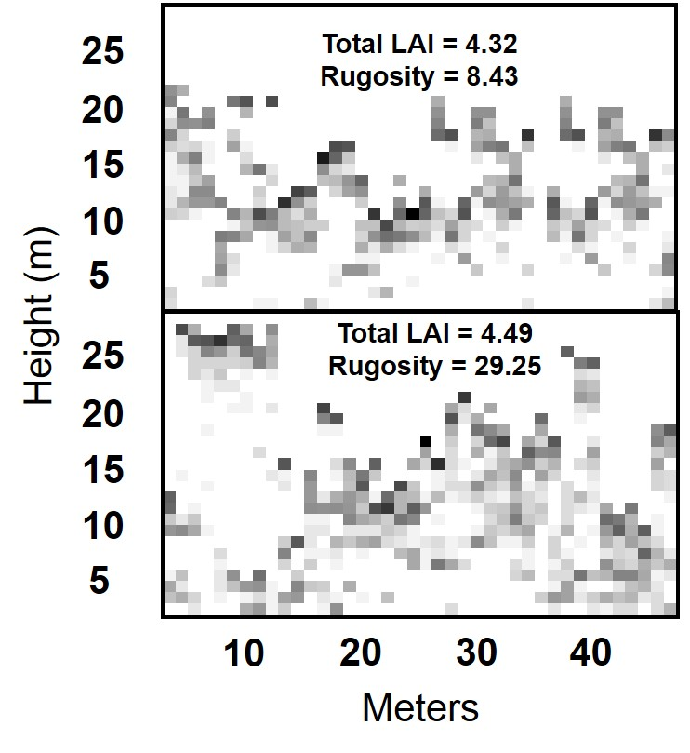
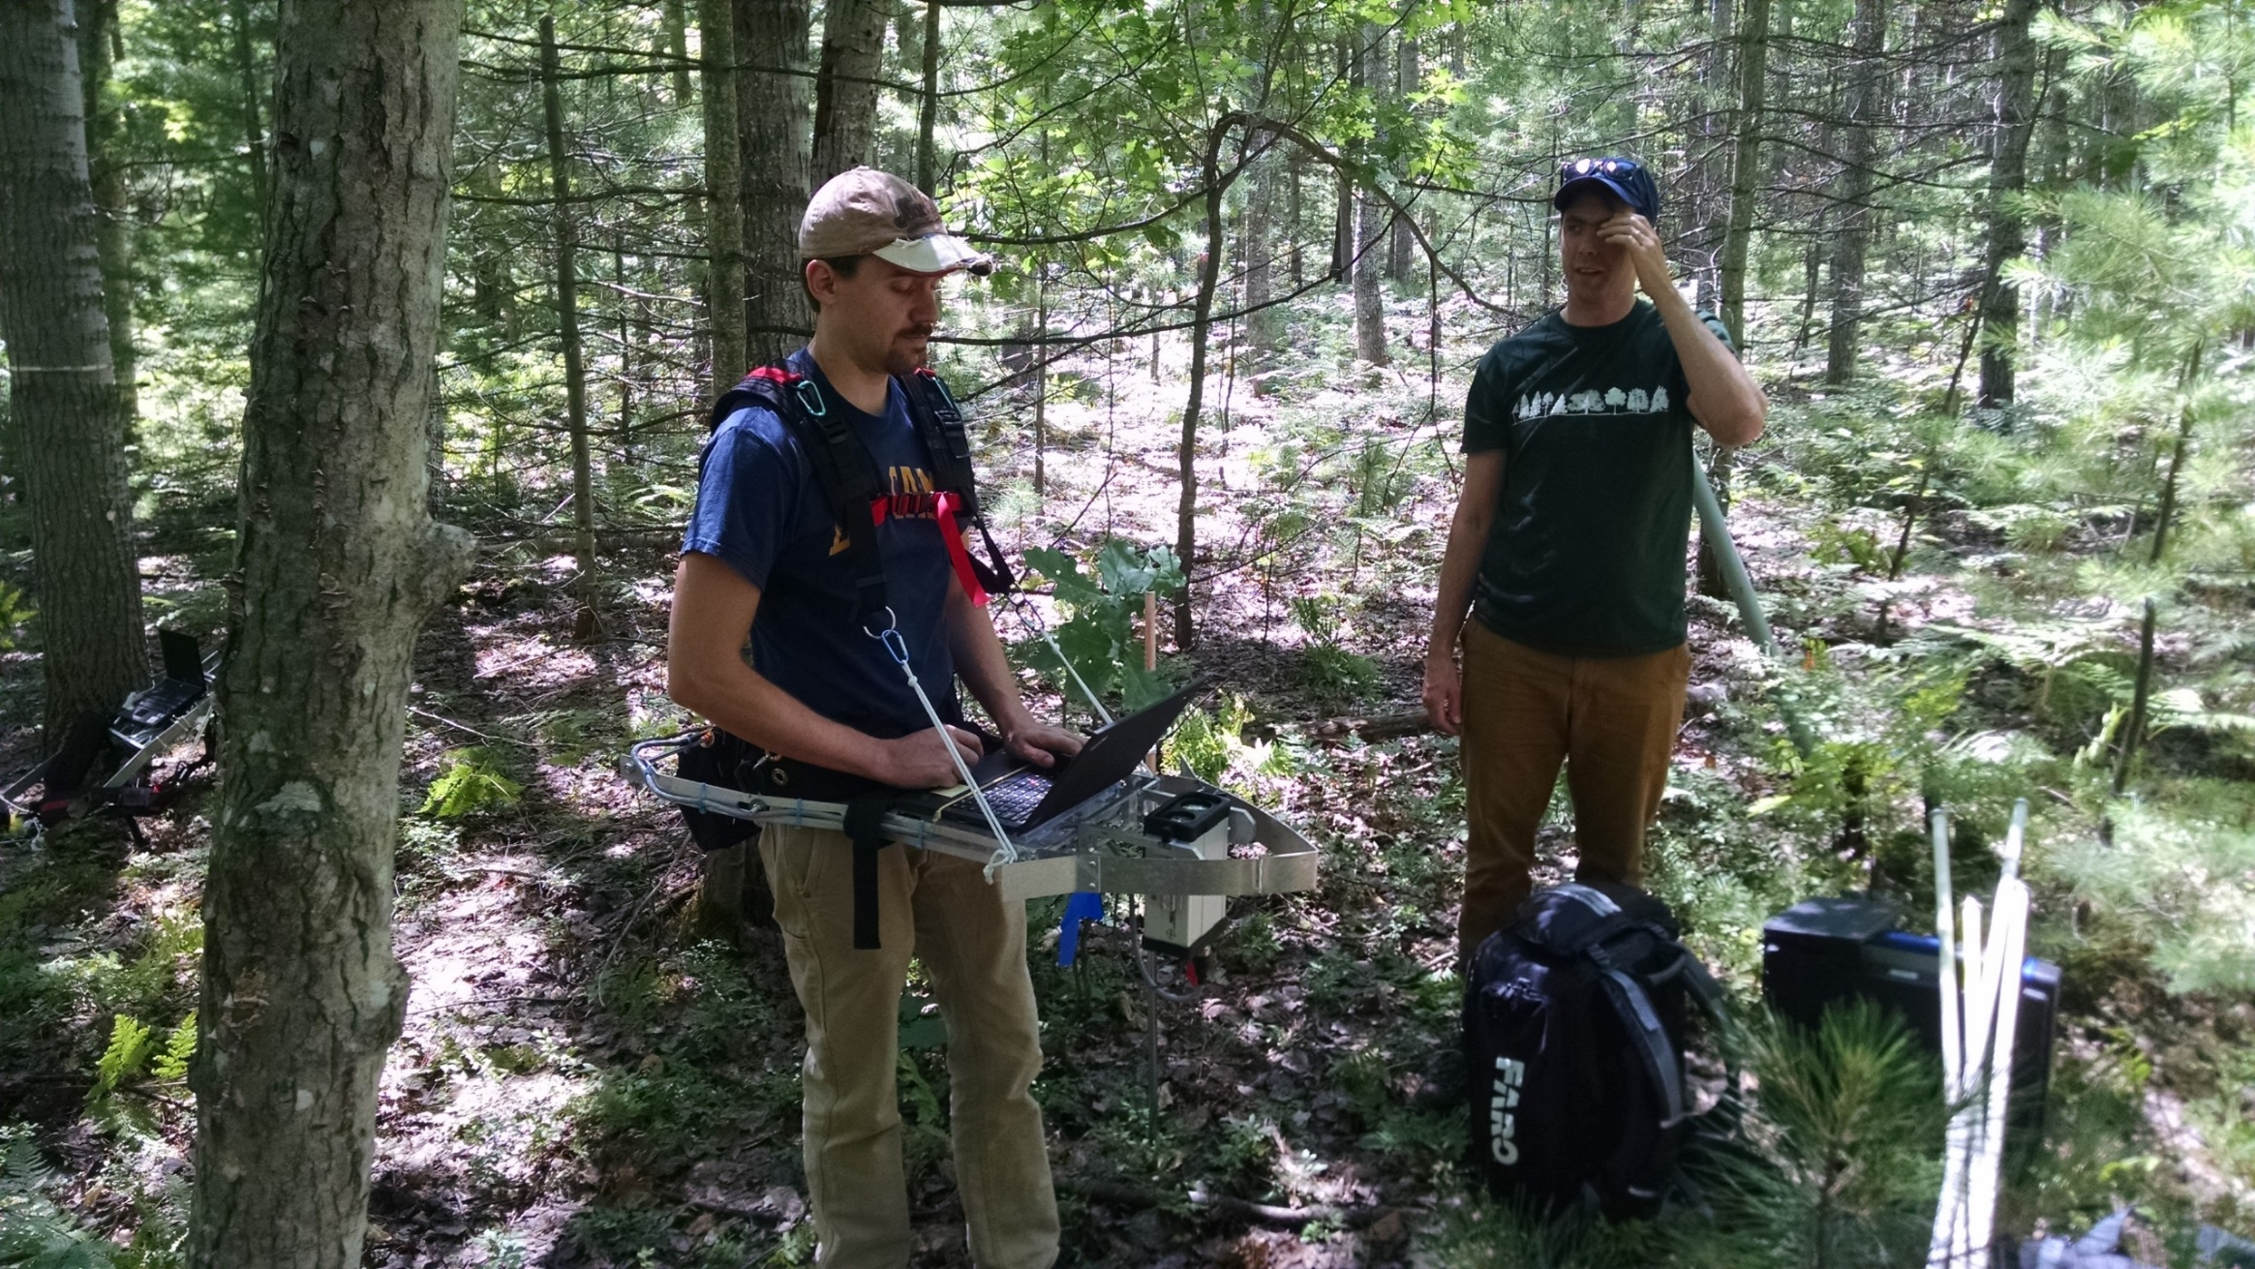
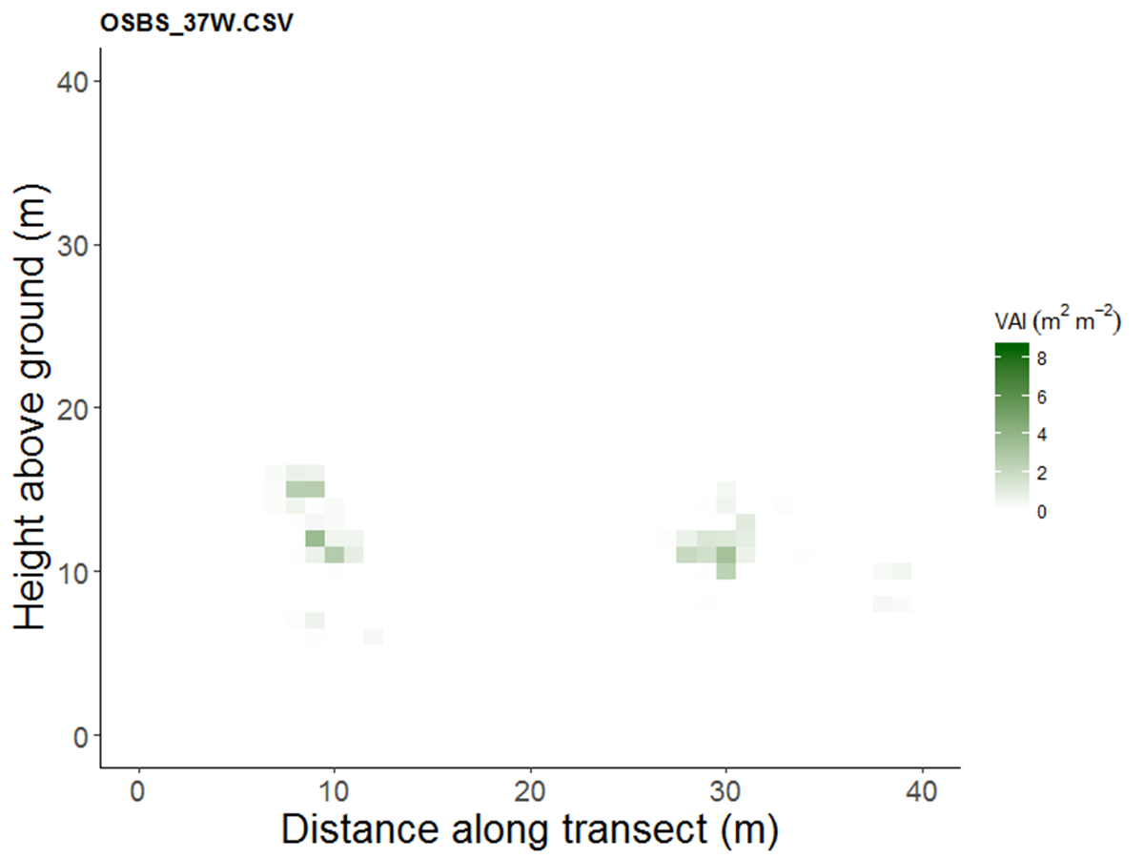
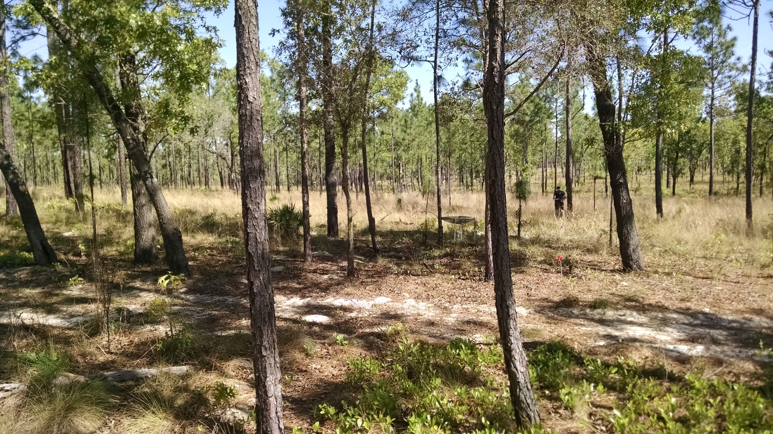
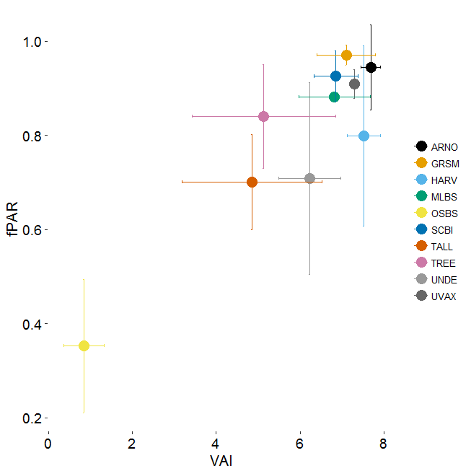
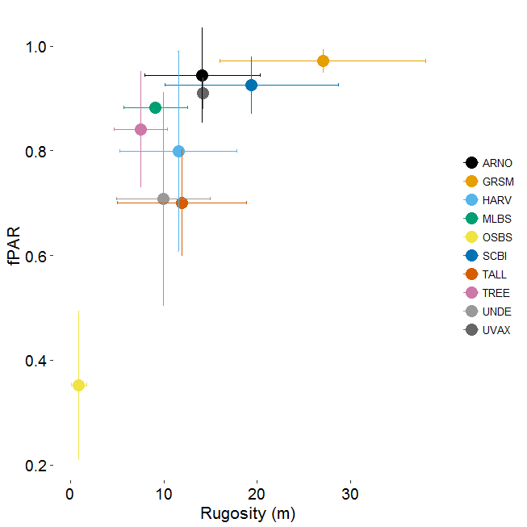
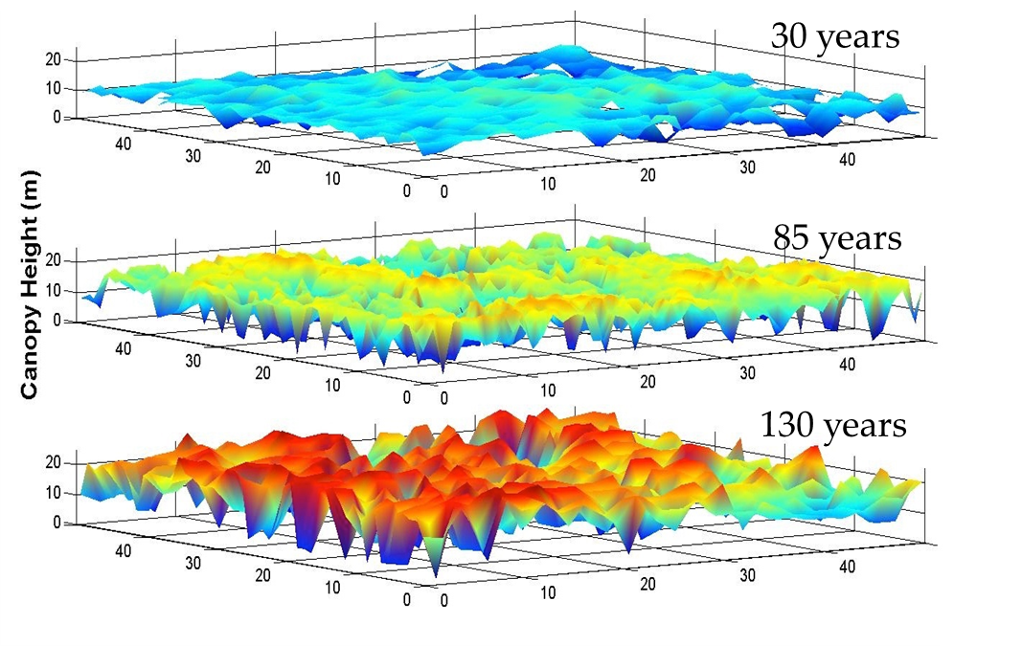
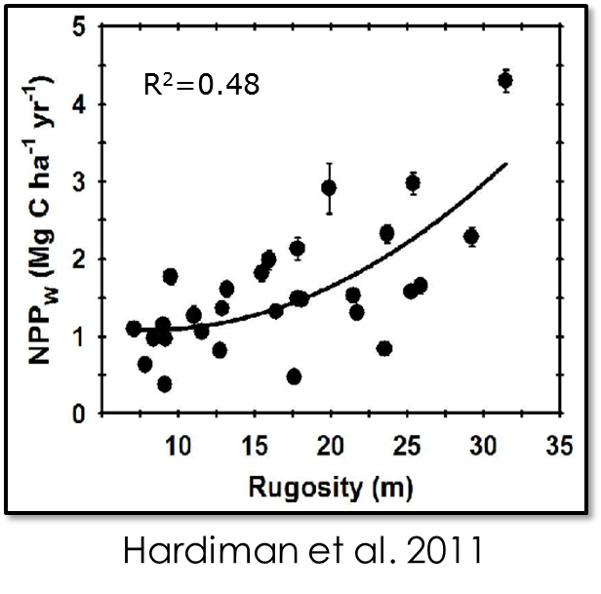
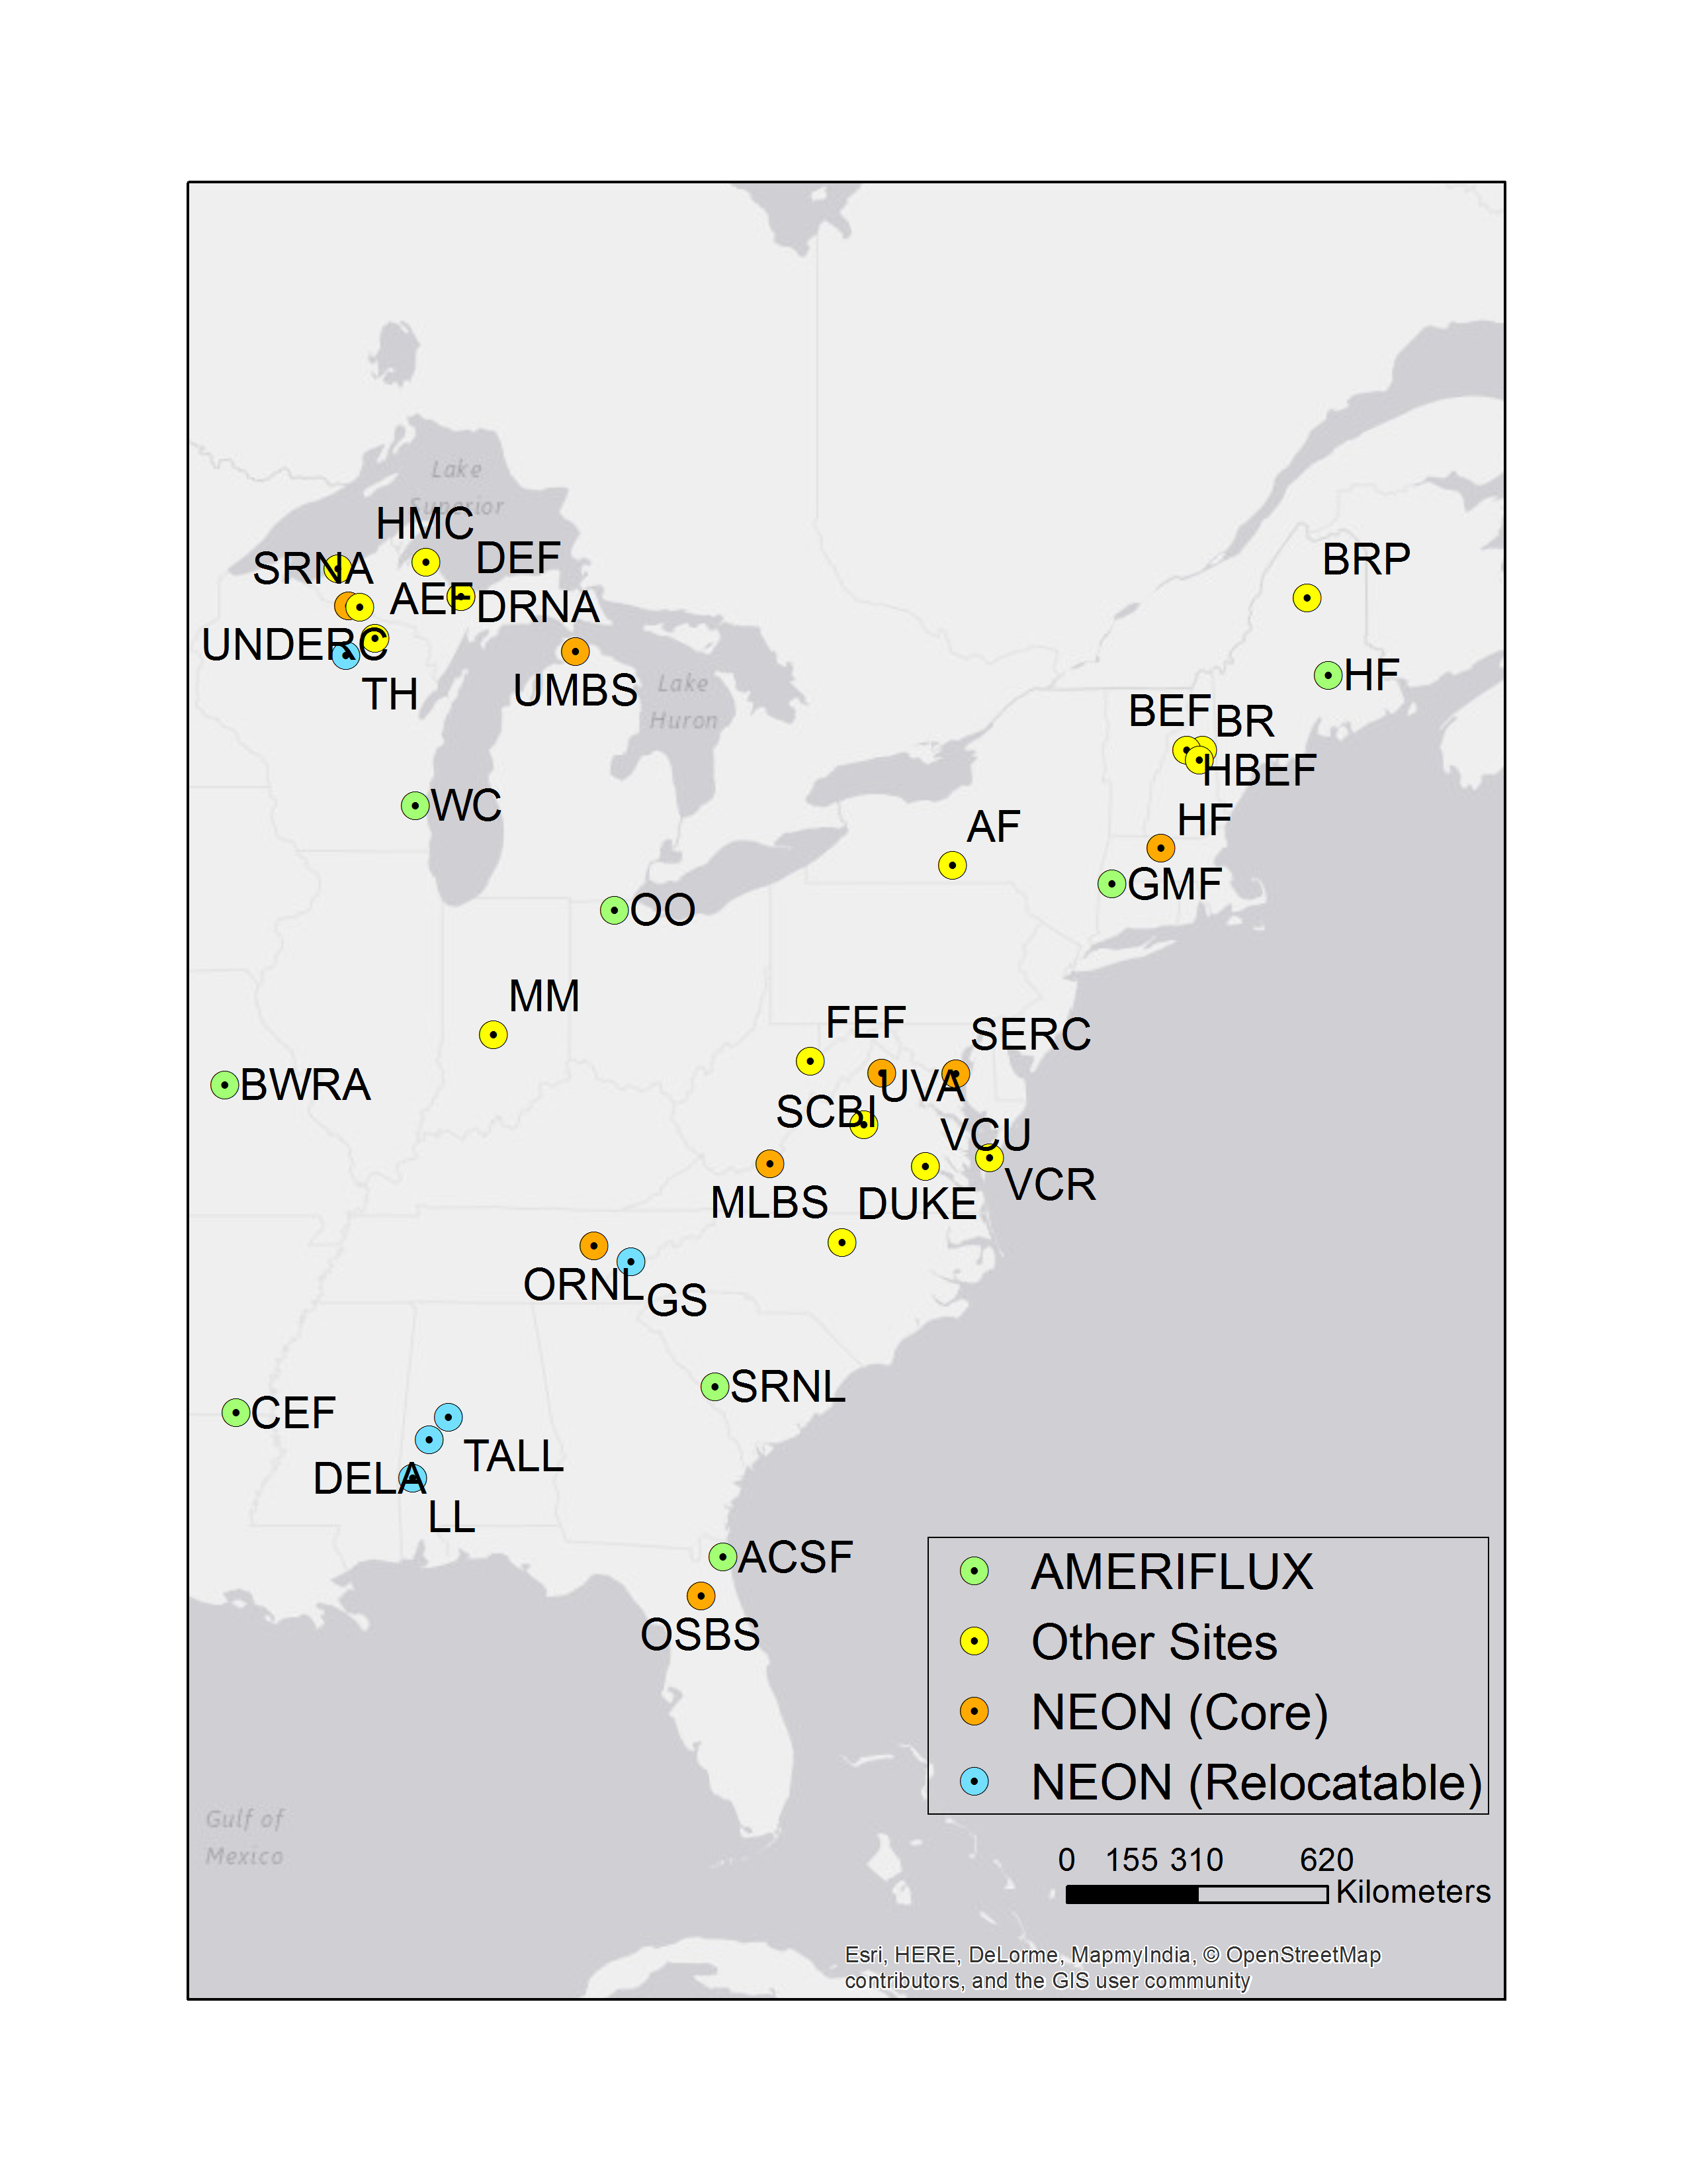
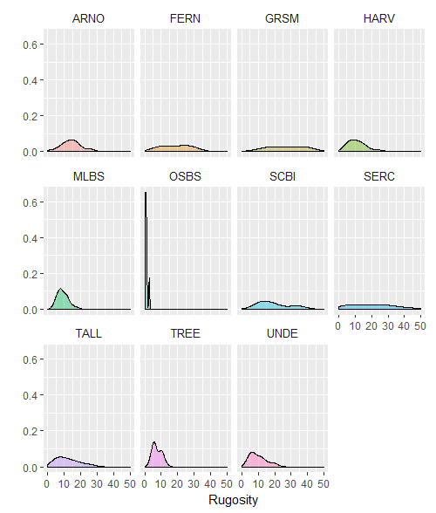
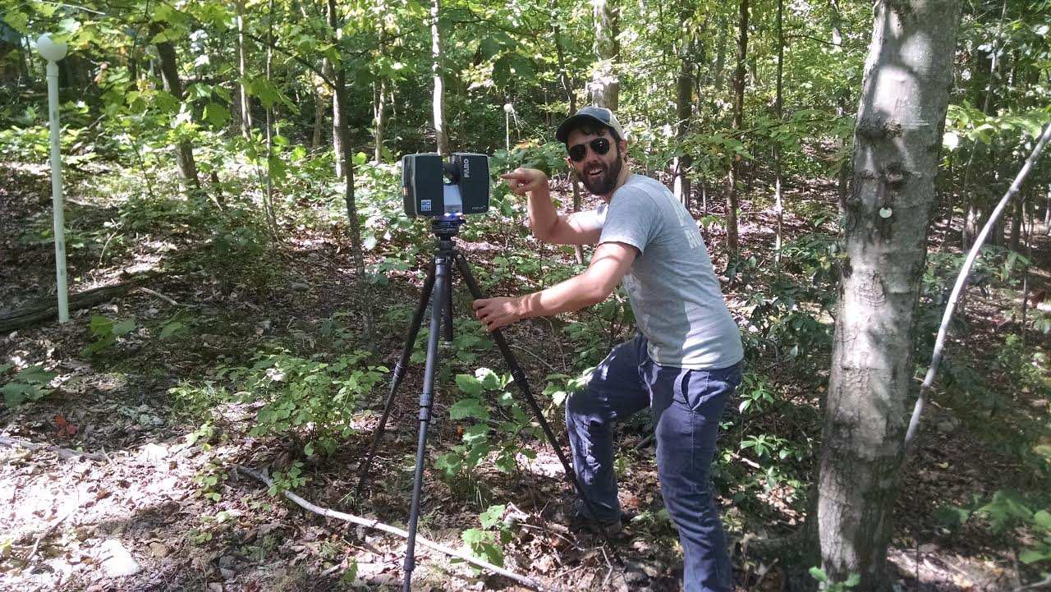
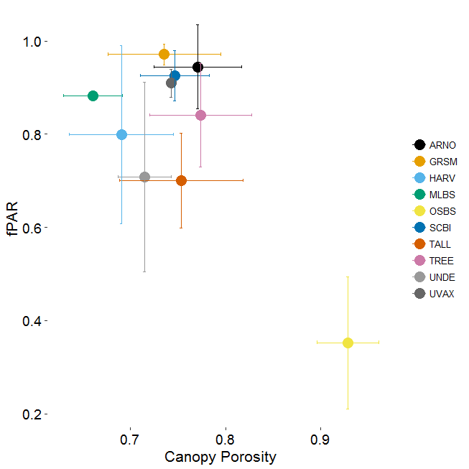
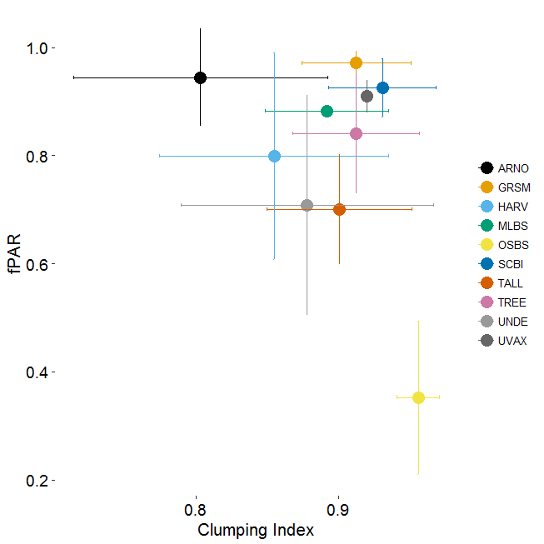



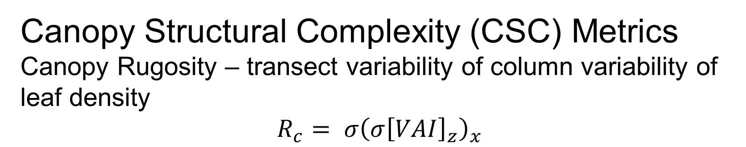
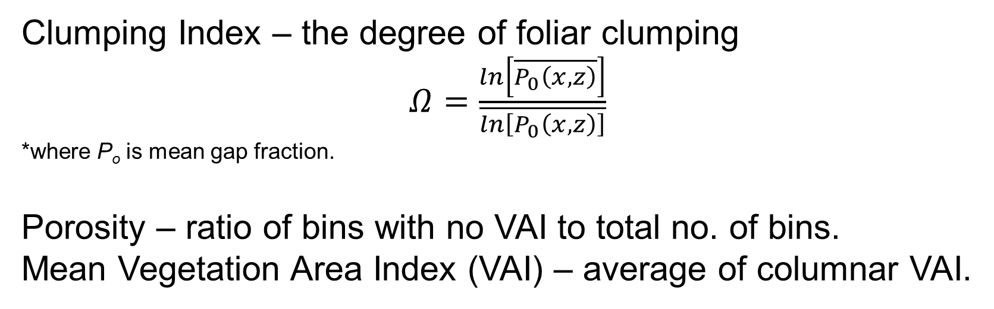
Using portable canopy LiDAR (PCL) to measure canopy structural complexity: forest structure-function relationships at the continental scale
Jeff W. Atkins^{1,4}, Chris Gough¹, Robert Fahey², and Brady Hardiman³
¹ Virginia Commonwealth University; Richmond, Virginia, ²University of Connecticut; Storrs, Connecticut; Purdue University; West Lafayette, Indiana; ⁴ Corresponding Author: jwatkins6@vcu.edu
Introduction Ecosystem structure-carbon (C) cycling relationships represent a long-standing research area for ecosystem science. Strong relationships between canopy structural complexity (CSC) and rates of C accumulation in plant biomass, or net primary productivity (NPP), have been demonstrated for a limited number of forest sites. Whether CSC-NPP relationships are broadly conserved across an array of structurally variable forest ecosystems is unknown, but the universality of this relationship has important implications for remotely sensing and modeling the terrestrial carbon cycle.
Canopy Structural Complexity (CSC) Metrics Canopy Rugosity – transect variability of column variability of leaf density $$R_{c}= {σ\left(σ{\left[VAI\right]}_{z}\right)}_{x}$$
High Complexity vs. Low Complexity Forests
R_{c} = 30 ~ 45 m
Well-developed canopy ►
◄Dense understory
High complexity cove hardwood forests in the Great Smoky Mountains of TN (NEON - GRSM)
R_{c} = 0.8 ~ 3 m
Clumping Index – the degree of foliar clumping
$Ω=\frac{ln\left[\overline{P_{0}\left(x,z\right)}\right]}{\overline{ln\left[P_{0}\left(x,z\right)\right]}}$
*where P_{o} is mean gap fraction.
Porosity – ratio of bins with no VAI to total no. of bins.
Mean Vegetation Area Index (VAI) – average of columnar VAI.
◄Isolated canopy
Lack of understory
Portable Canopy LiDAR
Reigl 3100VHS-FLP – near infrared pulsed laser firing upwards at 2000 Hz
Mounted on a custom, aluminum frame worn by the user (uncomfortably) and walked along transect.
Data Processing and Software
forestr – an open-source R package developed during the project (github.com/atkinsjeff/forestr)
Analyzes PCL data to produce a suite of canopy structural complexity (CSC) metrics
Future integration of TLS and other data forms
Ecological Implications
CSC varies through stand development
Drives resource efficiency
Additional, non-redundant information to LAI
Low complexity pine-oak Savanna in central, FL (Ordway-Swisher Biological Station (NEON - OSBS))
fPAR and CSC Relationships
fPAR measured during direct light conditions using a ceptometer
Non-linear relationships w. CSC metrics
VAI and Rugosity as strongest predictors of fPAR
Potential for informing radiative transfer models
CSC at the Continental Scale
Field work in 2016 included 15 sites, with more slated for 2017
Ecoregions range from complex cove hardwood forests in the Great Smoky Mountains to pine-oak savannas in Florida
Work in NEON, LTER, Ameriflux, and University affiliated sites.
Emerging Frontiers No. 1550657
Continental variance in rugosity
Additional Information at goo.gl/1RxIGG
Hardiman et al. Forests, 2013 (doi:10.3390/f4030537)
Hardiman et al. Ecology, 2011 (doi:10.1890/10-2191.1) Parker et al. 2003 (doi:10.14358/PERS.69.3.267
Preliminary work at the University of Virginia to pair PCL and TLS
@atkinsjeff

